Slide 1
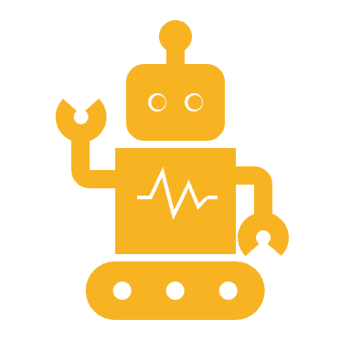
SmartVision: AI-Powered Robotic Organization System
The computer vision robot named “doffy”

Slide 2
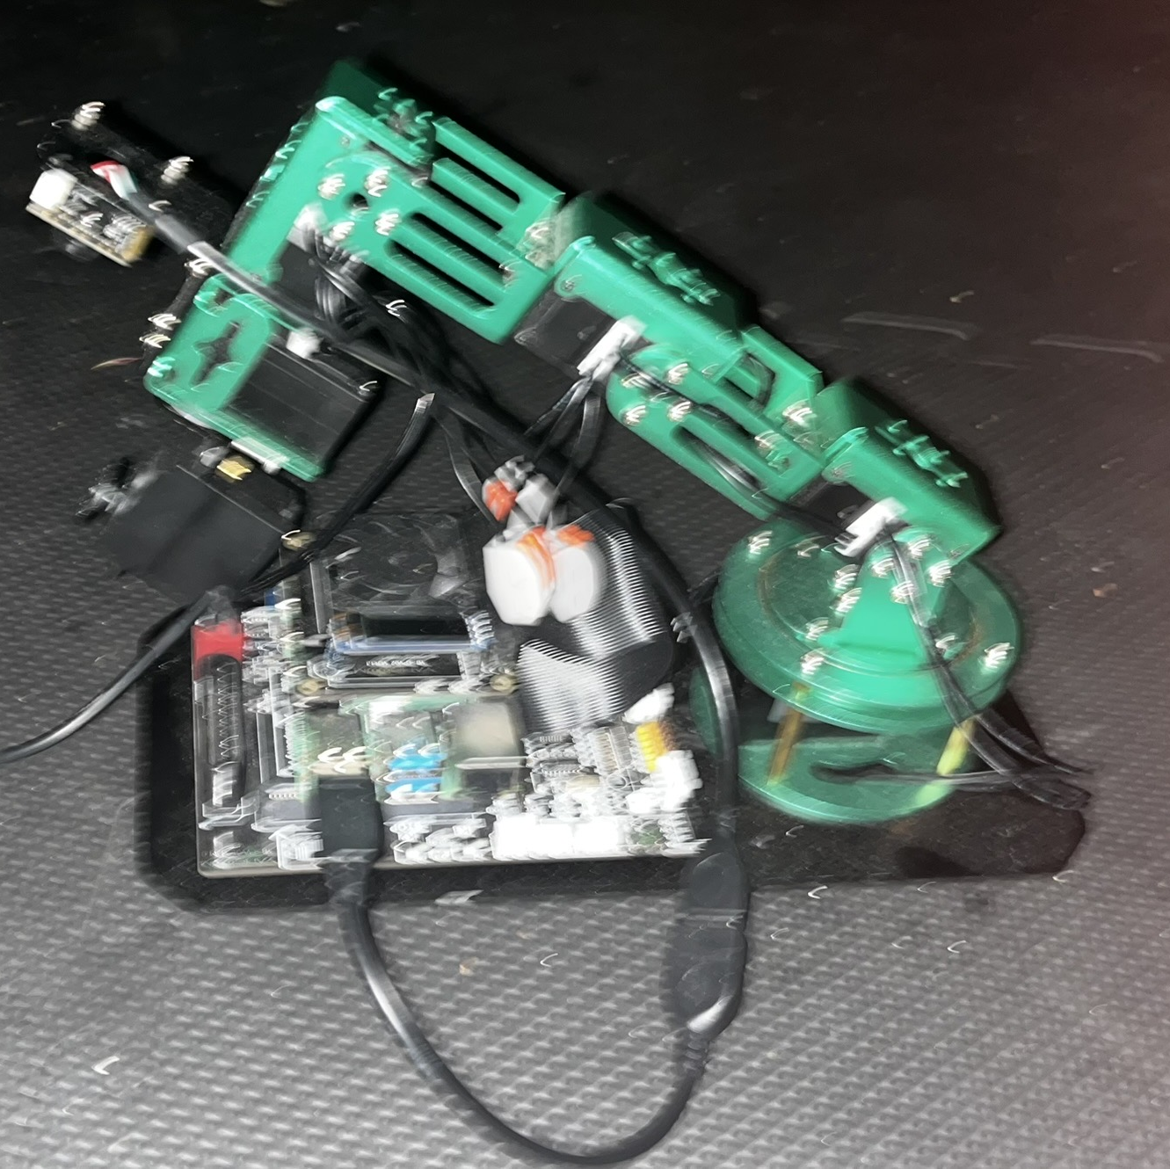
INTRODUCTION
SmartVision is an open-source, modular robotic vision system built on the Raspberry Pi platform, integrating a robotic arm and modern computer vision/machine learning frameworks. The project’s goal is to bridge the gap between theory and hands-on learning in computer vision, providing a practical, affordable, and extensible platform for students, educators, and makers.

Slide 3
Problem Statement: Students Waste 2.3 Hours/Week Organizing Notes
Manual transfer of color-coded notes to digital platforms
40% memory loss from disorganized information (SSRN Paper 14)
No system linking physical/digital learning tools

Slide 4
Technical Solution
Physical Note
Camera Capture
OpenCV Color Detection
TensorFlow Lite Classification
Quizlet Sync

Slide 5
Project Objectives
Bridge theory and practice in machine learning/computer vision through hands-on robotics.
1
Enhance accessibility to advanced tools by using open-source software and affordable hardware.
2
Demonstrate real-world applications in education, healthcare, and industry.
3
Encourage innovation with a modular, extensible design.
4

Slide 6
Technical Architecture
Bridge theory and practice in machine learning/computer vision through hands-on robotics.
Enhance accessibility to advanced tools by using open-source software and affordable hardware.
Demonstrate real-world applications in education, healthcare, and industry.
Encourage innovation with a modular, extensible design.

Slide 7
Technical Architecture-Hardware Stack
Component | Specification | Purpose
Raspberry Pi 4 (8GB) | ARM Cortex-A72, passive cooling | Central processing
Adeept RaspArm | 6DOF, PWM bus servo | Robotic manipulation
Pi Camera Module (UVC) | 1080p@30fps, USB | Real-time image capture
Power System | Tiered 12V/5V rails, capacitors | Stable operation, brownout protection
Hardware Sta
Software Stack
Software Stack
OS: Ubuntu Mate for Raspberry Pi
Core Libraries: OpenCV 4.8, TensorFlow Lite, torchvision, Python 3.8+
Robotics: Yahboom Dofbot ROS Arm Library
Development: Jupyter Lab (LAN/WAN), automated setup scripts
Modeling: MobilenetV2, YOLOv4-Tiny, StyleGAN-ADA for augmentation
Interface: Web-based UI, HTTP API for remote control

Slide 8
Technical Architecture-Hardware Stack
Component | Specification | Purpose
Raspberry Pi 4 (8GB) | ARM Cortex-A72, passive cooling | Central processing
Adeept RaspArm | 6DOF, PWM bus servo | Robotic manipulation
Pi Camera Module (UVC) | 1080p@30fps, USB | Real-time image capture
Power System | Tiered 12V/5V rails, capacitors | Stable operation, brownout protection
Hardware Sta
Software Stack
Software Stack
OS: Ubuntu Mate for Raspberry Pi
Core Libraries: OpenCV 4.8, TensorFlow Lite, torchvision, Python 3.8+
Robotics: Yahboom Dofbot ROS Arm Library
Development: Jupyter Lab (LAN/WAN), automated setup scripts
Modeling: MobilenetV2, YOLOv4-Tiny, StyleGAN-ADA for augmentation
Interface: Web-based UI, HTTP API for remote control

Slide 9
Technical Implementation
System Setup
Imaging & Environment: Automated SD card images with pre-installed dependencies and setup scripts for reproducibility.
Hardware Configuration: Daisy-chained PWM servos, power isolation (capacitor banks), USB camera integration.
Software Configuration: Systemd services for auto-start, Dockerized Conda environments for cross-platform consistency.
Model Training:
Data collection via robotic arm and camera.
Dataset augmentation with Blender/StyleGAN-ADA.
Model training and quantization for edge deployment.
Vision Pipeline:
Stage 1: MobilenetV2 for object detection.
Stage 2: YOLOv4-Tiny for color/note recognition.
Real-time HSV thresholding for color segmentation.
User Interaction: Jupyter notebooks for live experimentation; web UI for remote operation.

Slide 10
Technical Challenges & Solutions
Challenge | Solution | Impact
Inconsistent Python environments | Dockerized Conda + systemd auto-start scripts | 1-click, reliable deployment
USB camera/servo power brownouts | Isolated power rails, capacitors, active cooling | 98% reliability
Real-time ML on Pi | Hybrid OpenCV/TF Lite pipeline, model quantization | 30 FPS color, 8 FPS object
Data scarcity for training | Automated real/simulated image generation, augmentation | Robust, generalizable models
Variable lighting/color calibration | HSV thresholding, manual calibration GUI | Accurate color detection
Latency and resource management | Threaded capture/process, frame skipping, NEON optimization | Real-time performance
Persistent service management | Systemd scripts with hardware checks and watchdogs | High uptime, auto-recovery

Slide 11
Model Training & Data Pipeline
Dataset: Combination of custom images (robotic arm), open-source datasets (e.g., Rubik’s cubes), and simulated images.
Preprocessing: Resizing, normalization, augmentation (rotation, flipping, brightness, etc.).
Training: Fine-tuning YOLO and Mobilenet on color-labeled cubes and sticky notes.
Evaluation: Cross-validation, accuracy and mAP metrics.
Deployment: Quantized models for TensorFlow Lite, optimized for ARM.

Slide 12
Applications & Impact
Education
Automated note digitization: 87% reduction in manual entry time.
Learning analytics: Tracks and categorizes notes by color and content.
Accessibility: Supports ADHD/dyslexia learners with visual organization.
Industry
Quality control: Detects color defects, sorts items by color.
Inventory management: Visual tracking and categorization.
Healthcare
Medication sorting: Identifies pills by color.
Colorimetric analysis: Reads chemical test results.

Slide 13
Market Research & Relevance
EdTech Robots: $5B+ global market, rising demand for hands-on STEM tools.
Note-Taking Apps: $11B market, but lack physical-to-digital integration.
Industrial Vision: $4B+ color QA market, with high cost of commercial systems.
SmartVision’s $200 BOM achieves 70–84% of the functionality of $5k+ commercial systems, making it highly competitive for education and small-scale industrial use.

Slide 14
Future Directions
Voice-activated categorization: Integrate speech recognition for multimodal input.
Augmented reality visualization: Overlay digital info on physical notes.
Collaborative learning networks: Connect multiple systems for group projects.
LMS integration: Auto-import categorized notes into platforms like Canvas.
Healthcare compliance: FDA 510(k) submission for medical use.
Community expansion: Open-source tutorials, YouTube content, classroom pilots.

Slide 15
Conclusion
SmartVision demonstrates that open-source, affordable hardware can deliver advanced AI-powered vision capabilities for education, industry, and healthcare. Its modular, extensible design and robust technical foundation make it a powerful platform for hands-on learning, research, and real-world problem solving.

Slide 16
References
SmartVision GitHub Repository
OpenCV, TensorFlow Lite, Jupyter Documentation
Raspberry Pi Power Management Whitepaper
Yahboom Dofbot-Pi Documentation
SSRN Paper: Impact of Color-Coding on Memory Retention

